Slide 1
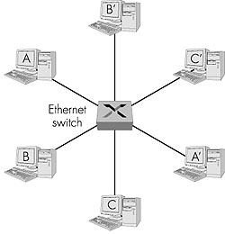
Ethernet Switches
layer 2 (frame) forwarding, filtering using LAN addresses
Switching: A-to-B and A’-to-B’ simultaneously, no collisions
large number of interfaces
often: individual hosts, star-connected into switch
  Ethernet, but no collisions!

Slide 2
Ethernet Switches
cut-through switching: frame forwarded from input to output port without awaiting for assembly of entire frame
  slight reduction in latency
combinations of shared/dedicated, 10/100/1000 Mbps interfaces

Slide 3
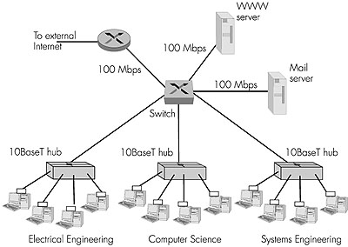
Ethernet Switches (more)
Dedicated
Shared

Slide 4
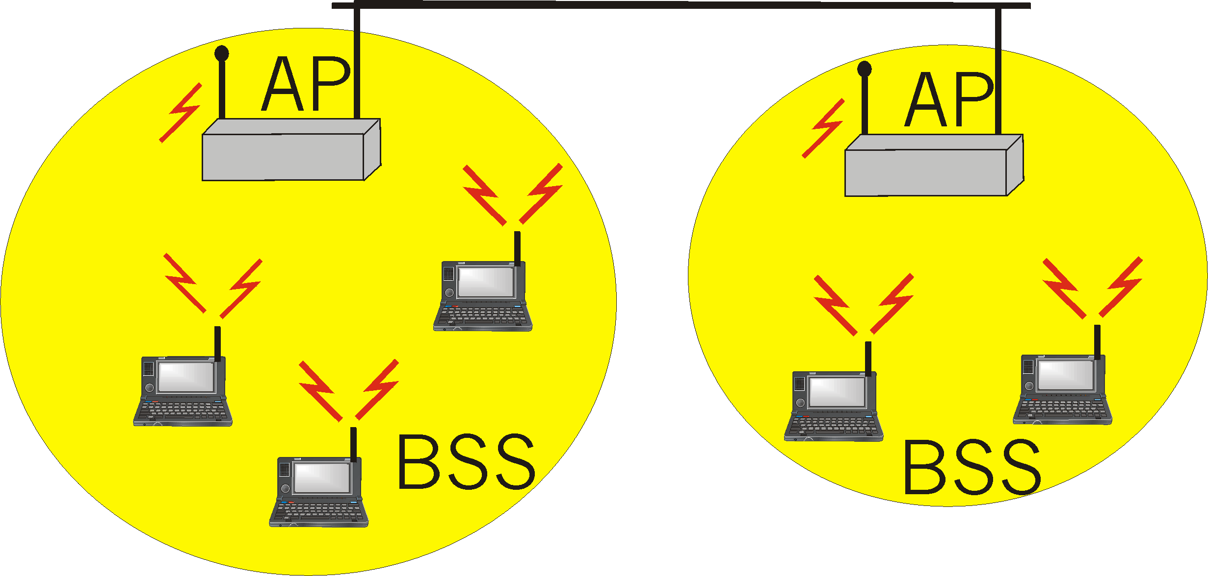
IEEE 802.11 Wireless LAN
wireless LANs: untethered (often mobile) networking
IEEE 802.11 standard:
  MAC protocol
  unlicensed frequency spectrum: 900Mhz, 2.4Ghz
Basic Service Set (BSS) (a.k.a. “cell”) contains:
  wireless hosts
  access point (AP): base station
BSS’s combined to form distribution system (DS)

Slide 5
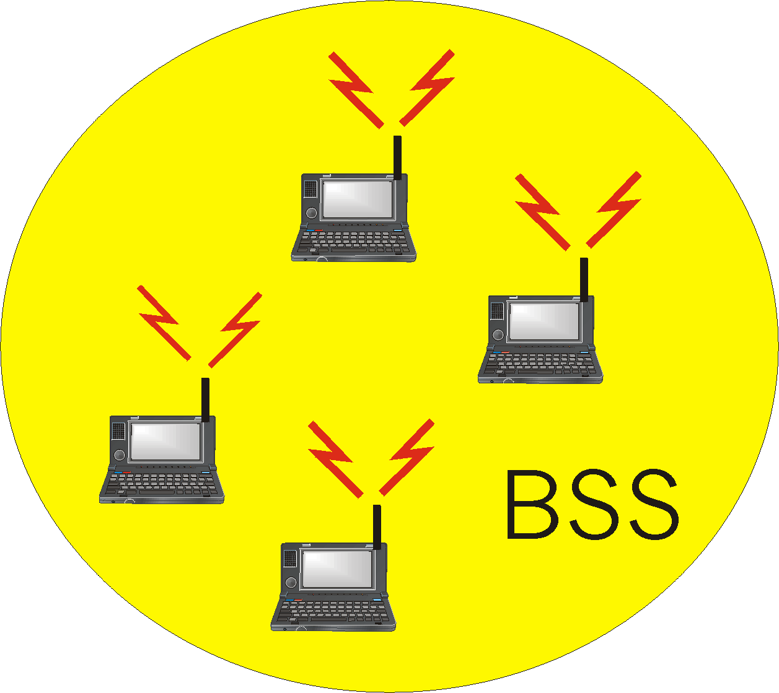
Ad Hoc Networks
Ad hoc network: IEEE 802.11 stations can dynamically form network without AP
Applications:
  “laptop” meeting in conference room, car
  interconnection of “personal” devices
  battlefield
IETF MANET
(Mobile Ad hoc Networks)
working group

Slide 6
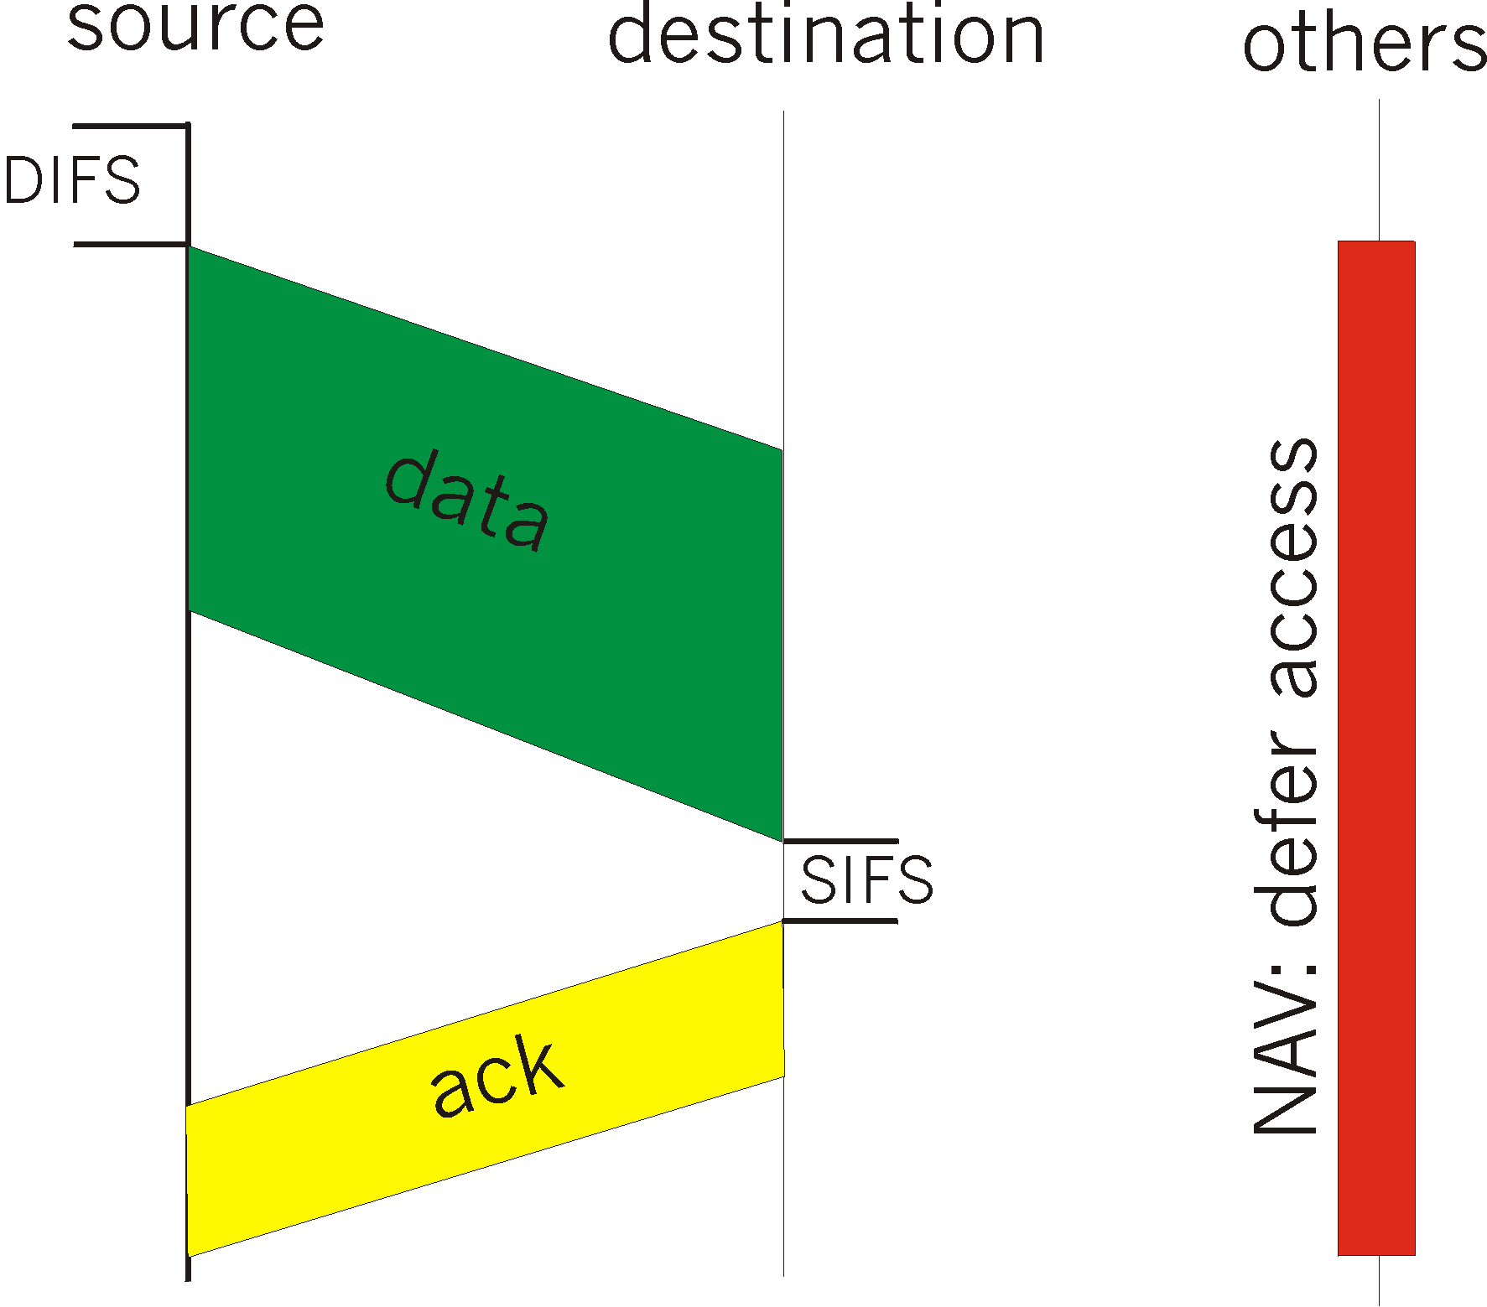
IEEE 802.11 MAC Protocol: CSMA/CA
802.11 CSMA: sender
- if sense channel idle for DIFS sec.
then transmit entire frame (no collision detection)
-if sense channel busy
then binary backoff
802.11 CSMA receiver:
if received OK
return ACK after SIFS

Slide 7
IEEE 802.11 MAC Protocol
802.11 CSMA Protocol: others
NAV: Network Allocation
Vector
802.11 frame has transmission time field
others (hearing data) defer access for NAV time units

Slide 8
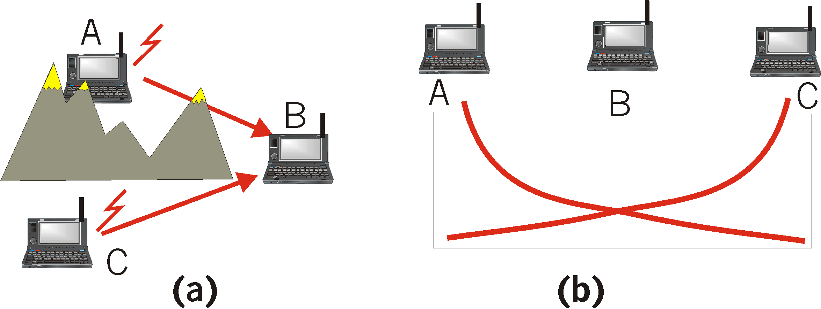
Hidden Terminal effect
hidden terminals: A, C cannot hear each other
  obstacles, signal attenuation
  collisions at B
goal: avoid collisions at B
CSMA/CA: CSMA with Collision Avoidance

Slide 9
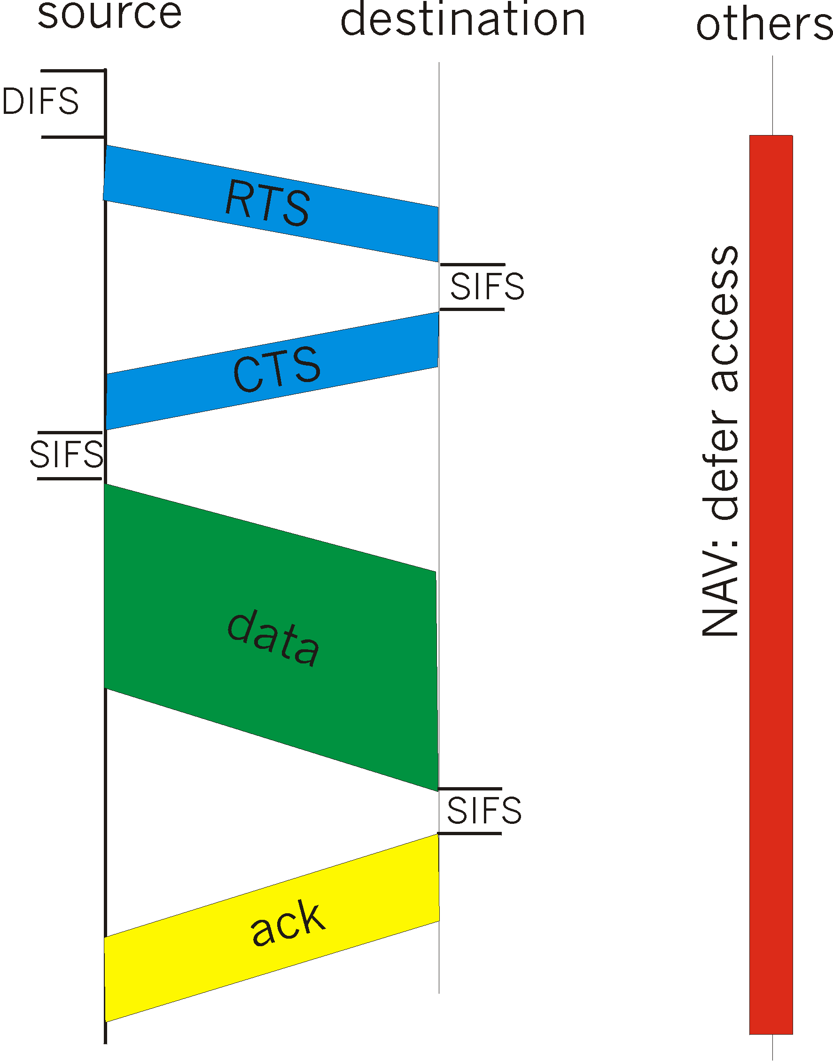
Collision Avoidance: RTS-CTS exchange
CSMA/CA: explicit channel reservation
  sender: send short RTS: request to send
  receiver: reply with short CTS: clear to send
CTS reserves channel for sender, notifying (possibly hidden) stations
avoid hidden station collisions

Slide 10
Collision Avoidance: RTS-CTS exchange
RTS and CTS short:
  collisions less likely, of shorter duration
  end result similar to collision detection
IEEE 802.11 alows:
  CSMA
  CSMA/CA: reservations
  polling from AP

Slide 11
Point to Point Data Link Control
one sender, one receiver, one link: easier than broadcast link:
  no Media Access Control
  no need for explicit MAC addressing
  e.g., dialup link, ISDN line
popular point-to-point DLC protocols:
  PPP (point-to-point protocol)
  HDLC: High level data link control (Data link used to be considered “high layer” in protocol stack!

Slide 12
PPP Design Requirements [RFC 1557]
packet framing: encapsulation of network-layer datagram in data link frame
  carry network layer data of any network layer protocol (not just IP) at same time
  ability to demultiplex upwards
bit transparency: must carry any bit pattern in the data field
error detection (no correction)
connection livenes: detect, signal link failure to network layer
network layer address negotiation: endpoint can learn/configure each other’s network address

Slide 13
PPP non-requirements
no error correction/recovery
no flow control
out of order delivery OK
no need to support multipoint links (e.g., polling)
Error recovery, flow control, data re-ordering
all relegated to higher layers!|

Slide 14

PPP Data Frame
Flag: delimiter (framing)
Address: does nothing (only one option)
Control: does nothing; in the future possible multiple control fields
Protocol: upper layer protocol to which frame delivered (eg, PPP-LCP, IP, IPCP, etc)

Slide 15
PPP Data Frame
info: upper layer data being carried
check: cyclic redundancy check for error detection

Slide 16
Byte Stuffing
“data transparency” requirement: data field must be allowed to include flag pattern <01111110>
  Q: is received <01111110> data or flag?
Sender: adds (“stuffs”) extra < 01111110> byte after each < 01111110> data byte
Receiver:
  two 01111110 bytes in a row: discard first byte, continue data reception
  single 01111110: flag byte

Slide 17

Byte Stuffing
flag byte
pattern
in data
to send
flag byte pattern plus
stuffed byte in transmitted data

Slide 18

PPP Data Control Protocol
Before exchanging network-layer data, data link peers must
configure PPP link (max. frame length, authentication)
learn/configure network
layer information
  for IP: carry IP Control Protocol (IPCP) msgs (protocol field: 8021) to configure/learn IP address

Slide 19
Asynchronous Transfer Mode: ATM
1980s/1990’s standard for high-speed (155Mbps to 622 Mbps and higher) Broadband Integrated Service Digital Network architecture
Goal: integrated, end-end transport of carry voice, video, data
  meeting timing/QoS requirements of voice, video (versus Internet best-effort model)
  “next generation” telephony: technical roots in telephone world
  packet-switching (fixed length packets, called “cells”) using virtual circuits

Slide 20
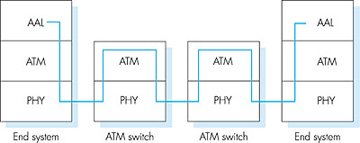
ATM architecture
adaptation layer: only at edge of ATM network
  data segmentation/reassembly
  roughly analagous to Internet transport layer
ATM layer: “network” layer
  cell switching, routing
physical layer

Slide 21
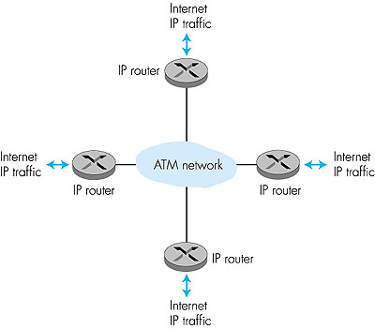
ATM: network or link layer?
Vision: end-to-end transport: “ATM from desktop to desktop”
  ATM is a network technology
Reality: used to connect IP backbone routers
  “IP over ATM”
  ATM as switched link layer, connecting IP routers

Slide 22
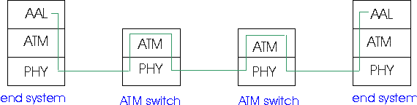
ATM Adaptation Layer (AAL)
ATM Adaptation Layer (AAL): “adapts” upper layers (IP or native ATM applications) to ATM layer below
AAL present only in end systems, not in switches
AAL layer segment (header/trailer fields, data) fragmented across multiple ATM cells
  analogy: TCP segment in many IP packets

Slide 23
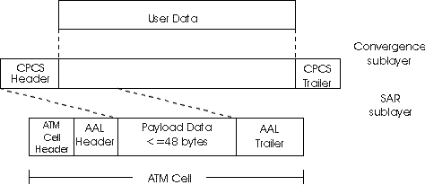
ATM Adaption Layer (AAL) [more]
Different versions of AAL layers, depending on ATM service class:
AAL1: for CBR (Constant Bit Rate) services, e.g. circuit emulation
AAL2: for VBR (Variable Bit Rate) services, e.g., MPEG video
AAL5: for data (eg, IP datagrams)
User data
AAL PDU
ATM cell

Slide 24

AAL5 - Simple And Efficient AL (SEAL)
AAL5: low overhead AAL used to carry IP datagrams
  4 byte cyclic redundancy check
  PAD ensures payload multiple of 48bytes
  large AAL5 data unit to be fragmented into 48-byte ATM cells

Slide 25
ATM Layer
Service: transport cells across ATM network
analagous to IP network layer
very different services than IP network layer
Network
Architecture
Internet
ATM
ATM
ATM
ATM
Service
Model
best effort
CBR
VBR
ABR
UBR
Guarantees ?
Congestion
feedback
no (inferred
via loss)
no
congestion
no
congestion
yes
no
Bandwidth
none
constant
rate
guaranteed
rate
guaranteed
minimum
none
Loss
no
yes
yes
no
no
Order
no
yes
yes
yes
yes
Timing
no
yes
yes
no
no

Slide 26
ATM Layer: Virtual Circuits
VC transport: cells carried on VC from source to dest
  call setup, teardown for each call before data can flow
  each packet carries VC identifier (not destination ID)
  every switch on source-dest path maintain “state” for each passing connection
  link,switch resources (bandwidth, buffers) may be allocated to VC: to get circuit-like perf.
Permanent VCs (PVCs)
  long lasting connections
  typically: “permanent” route between to IP routers
Switched VCs (SVC):
  dynamically set up on per-call basis

Slide 27
ATM VCs
Advantages of ATM VC approach:
  QoS performance guarantee for connection mapped to VC (bandwidth, delay, delay jitter)
Drawbacks of ATM VC approach:
  Inefficient support of datagram traffic
  one PVC between each source/dest pair) does not scale (N*2 connections needed)
  SVC introduces call setup latency, processing overhead for short lived connections

Slide 28

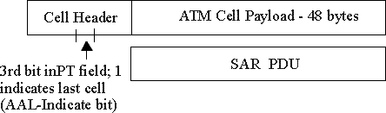
ATM Layer: ATM cell
5-byte ATM cell header
48-byte payload
  Why?: small payload -> short cell-creation delay for digitized voice
  halfway between 32 and 64 (compromise!)
Cell header
Cell format

Slide 29
ATM cell header
VCI: virtual channel ID
  will change from link to link thru net
PT: Payload type (e.g. RM cell versus data cell)
CLP: Cell Loss Priority bit
  CLP = 1 implies low priority cell, can be discarded if congestion
HEC: Header Error Checksum
  cyclic redundancy check

Slide 30
ATM Physical Layer (more)
Two pieces (sublayers) of physical layer:
Transmission Convergence Sublayer (TCS): adapts ATM layer above to PMD sublayer below
Physical Medium Dependent: depends on physical medium being used
TCS Functions:
  Header checksum generation: 8 bits CRC
  Cell delineation
  With “unstructured” PMD sublayer, transmission of idle cells when no data cells to send

Slide 31
ATM Physical Layer
Physical Medium Dependent (PMD) sublayer
SONET/SDH: transmission frame structure (like a container carrying bits);
  bit synchronization;
  bandwidth partitions (TDM);
  several speeds: OC1 = 51.84 Mbps; OC3 = 155.52 Mbps; OC12 = 622.08 Mbps
TI/T3: transmission frame structure (old telephone hierarchy): 1.5 Mbps/ 45 Mbps
unstructured: just cells (busy/idle)

Slide 32

IP-Over-ATM
IP over ATM
replace “network” (e.g., LAN segment) with ATM network
ATM addresses, IP addresses
Classic IP only
3 “networks” (e.g., LAN segments)
MAC (802.3) and IP addresses
ATM
network
Ethernet
LANs
Ethernet
LANs

Slide 33
IP-Over-ATM
Issues:
IP datagrams into ATM AAL5 PDUs
from IP addresses to ATM addresses
  just like IP addresses to 802.3 MAC addresses!
ATM
network
Ethernet
LANs

Slide 34
Datagram Journey in IP-over-ATM Network
at Source Host:
  IP layer finds mapping between IP, ATM dest address (using ARP)
  passes datagram to AAL5
  AAL5 encapsulates data, segments to cells, passes to ATM layer
ATM network: moves cell along VC to destination
at Destination Host:
  AAL5 reassembles cells into original datagram
  if CRC OK, datgram is passed to IP

Slide 35
ARP in ATM Nets
ATM network needs destination ATM address
  just like Ethernet needs destination Ethernet address
IP/ATM address translation done by ATM ARP (Address Resolution Protocol)
  ARP server in ATM network performs broadcast of ATM ARP translation request to all connected ATM devices
  hosts can register their ATM addresses with server to avoid lookup

Slide 36
X.25 and Frame Relay
Like ATM:
wide area network technologies
virtual circuit oriented
origins in telephony world
can be used to carry IP datagrams
  can thus be viewed as Link Layers by IP protocol

Slide 37
X.25
X.25 builds VC between source and destination for each user connection
Per-hop control along path
  error control (with retransmissions) on each hop using LAP-B
    variant of the HDLC protocol
  per-hop flow control using credits
    congestion arising at intermediate node propagates to previous node on path
    back to source via back pressure

Slide 38
IP versus X.25
X.25: reliable in-sequence end-end delivery from end-to-end
  “intelligence in the network”
IP: unreliable, out-of-sequence end-end delivery
  “intelligence in the endpoints”
gigabit routers: limited processing possible
2000: IP wins

Slide 39
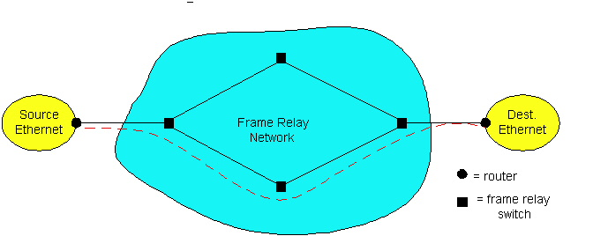
Frame Relay
Designed in late ‘80s, widely deployed in the ‘90s
Frame relay service:
  no error control
  end-to-end congestion control

Slide 40
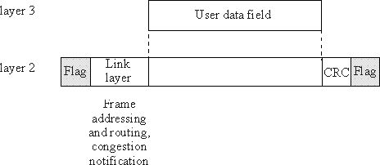
Frame Relay (more)
Designed to interconnect corporate customer LANs
  typically permanent VC’s: “pipe” carrying aggregate traffic between two routers
  switched VC’s: as in ATM
corporate customer leases FR service from public Frame Relay network (eg, Sprint, ATT)

Slide 41
Frame Relay (more)
flags
address
data
CRC
flags
Flag bits, 01111110, delimit frame
address:
  10 bit VC ID field
  3 congestion control bits
    FECN: forward explicit congestion notification (frame experienced congestion on path)
    BECN: congestion on reverse path
    DE: discard eligibility

Slide 42
Frame Relay -VC Rate Control
Committed Information Rate (CIR)
  defined, “guaranteed” for each VC
  negotiated at VC set up time
  customer pays based on CIR
DE bit: Discard Eligibility bit
  Edge FR switch measures traffic rate for each VC; marks DE bit
  DE = 0: high priority, rate compliant frame; deliver at “all costs”
  DE = 1: low priority, eligible for discard when congestion

Slide 43
Frame Relay - CIR & Frame Marking
Access Rate: rate R of the access link between source router (customer) and edge FR switch (provider); 64Kbps < R < 1,544Kbps
Typically, many VCs (one per destination router) multiplexed on the same access trunk; each VC has own CIR
Edge FR switch measures traffic rate for each VC; it marks
(ie DE <= 1) frames which exceed CIR (these may be later dropped)

Slide 44
Chapter 5: Summary
principles behind data link layer services:
  error detection, correction
  sharing a broadcast channel: multiple access
  link layer addressing, ARP
various link layer technologies
  Ethernet
  hubs, bridges, switches
  IEEE 802.11 LANs
  PPP
  ATM
  X.25, Frame Relay
journey down the protocol stack now OVER!
  Next stops: security, network management

